Slide 1
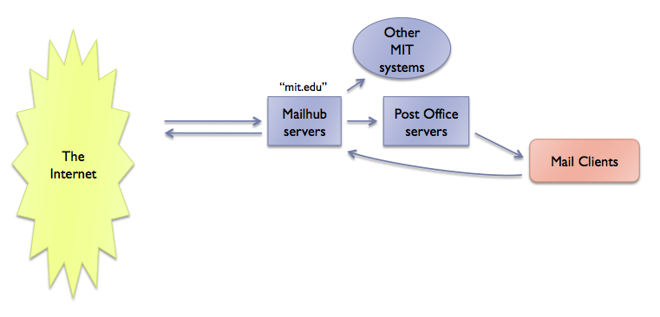
Mapping the MIT Mail System
An approximate sketch
Jacob Morzinski

Slide 2
Version 1: at first, things are simple
Other
MIT systems
The Internet
“mit.edu”
Mailhub
servers
Post Office
servers
Mail Clients
The Mailhubs have delivery rules for every @mit.edu address
Delivery rules come from Moira lists and forwarding (chpobox)
Early mail clients are usually configured by experts

Slide 3
Version 2: personal computers arrive
The Internet
Other
MIT
“mit.edu”
Mailhub
servers
Post Office
servers
Mail Clients
“outgoing.mit.edu”
Outgoing
servers
Mail Clients
New mail clients (Eudora)
New SMTP server (outgoing.mit.edu)
Easier for novices to configure mail client this way

Slide 4
Version 3: don’t trust the Internet
The Internet
Other
MIT
“mit.edu”
DMZ
Mailhub
servers
Post Office
servers
Mail Clients
“outgoing.mit.edu”
Mail Clients
DMZ
Outgoing
servers
Mail Clients
Demilitarized Zone (DMZ) servers
Buffer against internet-based attacks
Internal mail insulated from external problems

Slide 5
Version 4: spam is annoying
The Internet
Spam Assassin
Other
MIT
“mit.edu”
DMZ
Mailhub
servers
Post Office
servers
Mail Clients
“outgoing.mit.edu”
Mail Clients
DMZ
Outgoing
servers
Mail Clients
Mailhubs route all mail through a mail filter (“milter”)
Mail filters include Spam Assassin and Anti-Virus scanning
Spam Assassin screens mail, assigns a “Spamscreen” score

Slide 6
Version 5: spam is a big problem
The Internet
Spam Assassin
Other
MIT
“mit.edu”
Barracuda
DMZ
Mailhub
servers
Post Office
servers
Mail Clients
“outgoing.mit.edu”
Mail Clients
DMZ
Outgoing
servers
Mail Clients
Barracuda, commercial product, fights spam
Can block obvious spam from ever reaching MIT

Slide 7
Version 6: add Exchange (simplified)
The Internet
Spam Assassin
Other
MIT
“mit.edu”
Mail Clients
Barracuda
DMZ
Mailhub
servers
Post Office
servers
Mail Clients
“outgoing.mit.edu”
Mail Clients
DMZ
Outgoing
servers
Mail Clients
Exchange
servers
Exchange server behaves much like the other Post Office servers
Exchange receives mail via standard Moira forwarding (chpobox)

Slide 8
Version 6b: add Exchange (detail)
Spam Assassin
Other
MIT
Brightmail
The Internet
“mit.edu”
Mail Clients
Barracuda
DMZ
Mailhub
servers
Post Office
servers
Mail Clients
“outgoing.mit.edu”
Mail Clients
DMZ
Outgoing
servers
Mail Clients
“exchange.mit.edu”
Brightmail
Outbound servers
Client-facing servers
Brightmail box fights spam,
puts stuff in Spam Quarantine
Exchange’s Outbound edge
server will rewrite headers:
“me@exchange.mit.edu” is
changed into “me@mit.edu”
Inbound servers
Exchange Mailbox servers

